Slide 1
HNDIT2302 IT Project Management

Slide 2
Module Data
Module Code HNDIT23022
Module Title IT Project Management
Credits 2
Hours/Week
Lectures 15
Lab/Tutorial 30
GPA/NGPA GPA
Semester 3
Module Type Core

Slide 3
Module Aims & Objectives
To develop an appreciation of key, generic project management concepts and techniques as well as those techniques and approaches those are specific to the management of software projects.

Slide 4
Learning Outcomes
At the end of the module the student will be able to:
Explain how a project can be broken down into stages and what each stage contributes to the project.
Select appropriate techniques to use in different stages of a project.
Justify the appropriateness of these techniques, and apply them to practical situations.
Explain the limitations of the project approach in developing information/software systems.
Explain the roles and responsibilities of a project manager.
Identify relevant software tools for different project management activities.

Slide 5

Outline Syllabus
Introduction to project management and the profile of a software project
Project Integration Management
Scope Management
Time Management
Cost Management
Quality Management
Human Resource Management
Communications Management
Risk Management
Procurement Management
Roles and responsibilities of a project Manager

Slide 6
Assessment & weighting
Continuous assessment
In Class participation, group work and Tutorials -50%
End Semester Examination
Structured Examination Paper- 50 %

Slide 7
Prescribed Text
Kathy Schwalbe, “Information Technology Project Management”, Sixth Edition, THOMSON Course
Technology, (ISBN 81-315-0123-X)
Steve McConnell, “Software Project Survival Guide”, Microsoft Press, ISBN: 1572316217
Harold Kerzner, “Project Management: A Systems Approach to Planning, Scheduling, and Controlling”, Wiley; 8th edition, ISBN: 0471225770

Slide 8
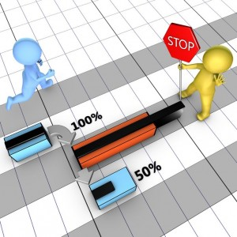
HNDIT2302 IT Project Management
Week 1
Introduction to project management and the profile of a software project

Slide 10
What is a Project?
Project is a temporary endeavor undertaken to create a unique product or service.
Projects are unique.
Projects are temporary in nature and have a definite beginning and end date.
Projects are completed when the project goals are achieved or it is determined the project is no longer viable.
A successful project is one that meets or exceeds the expectations of your stakeholders.

Slide 11
What is a Project?
A project can be considered to be any series of activities and tasks that:
Have a specific objective to be completed within certain specifications.
Have defined start and end dates.
Have funding limits (if applicable)
Consume human and nonhuman resources (i.e., money, people, equipment).
Are multifunctional (i.e., cut across several functional lines).

Slide 12
Project Attributes
Unique purpose
Temporary
Require resources, often from various areas
Should have a primary sponsor and/or customer
Involve uncertainty

Slide 13
Project Example
Building a road is an example of a project. The process of building a road takes a finite amount of time, and produces a unique product.
Operations, on the other hand, are repetitive. Generating bills every month, and broadcasting news everyday are examples of operations.
Subprojects are components of a project that often contracted out.

Slide 14
The Triple Constraint

Slide 15
The Triple Constraint
Every project is constrained in different ways by its scope, time and cost goals.
These limitations are sometimes referred to in project management as the triple constraint :
Scope goals: What is the project trying to accomplish?
Time goals: How long should it take to complete? What is the project’s schedule.
Cost goals: What should it cost to complete the project? What is the project’s budget?
It is the project manager’s duty to balance these three often competing goals

Slide 16
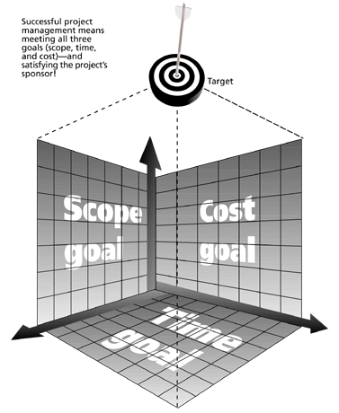
The Triple Constraint of PM
Successful project management means meeting all three goals (scope, time, cost) –and satisfying the project’s sponsor.

Slide 17
The Triple Constraint of PM , cont’
Although the triple constraints describes how the basic elements of a project –scope, time and cost – interrelate, other elements can also play significant roles.
Quality is often a key factor in projects.
Some people, in fact, refer to the ‘quadruple constraint’ of PM, including quality along with scope, time, and cost.

Slide 18
What is Project Management?
Project management is “the application of knowledge, skills, tools, and techniques to project activities in order to meet project requirements”
(PMI*, Project Management Body of Knowledge (PMBOK® Guide), 2000, p. 6)
*The Project Management Institute (PMI) is an international professional society

Slide 19
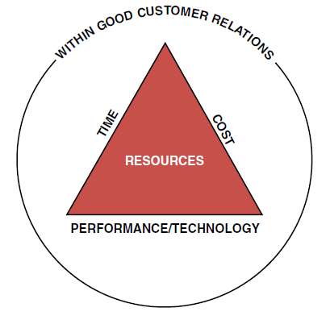
What is Project Management? ….
Project management is accomplished through the use of the processes such as:
Project initiation
Project planning
Project execution
Project monitoring and
control
Project closure

Slide 20
Project initiation
Select of the best project given resource limits.
Recognizing the benefits of the project
Preparation of the documents to approve the project.
Assigning of project manager

Slide 21
Project planning
Definition of the work requirements.
Definition of the quality and quality of work.
Definition of the resources needed
Scheduling the activities
Evaluation of the various risks

Slide 22
Project execution
Negotiating for the project team members
Directing and managing the work
Working with the team members to help them improve

Slide 23
Project Monitoring and control
Tracking progress
Comparing actual outcome to predicted outcome
Analyzing variances and impacts
Making adjustments

Slide 24
Project closure
Verifying that all of the work has been accomplished
Contractual closure of the contract
Financial closure of the charge number
Administrative closure of the paperwork

Slide 25
Successful Project Management
Successful project management can then be defined as having achieved the project objectives:
Within time
Within cost
At the desired performance/technology level
While utilizing the assigned resources effectively and efficiently
Accepted by the customer

Slide 26
Advantages of Using Formal Project Management
Better control of financial, physical, and human resources
Improved customer relations
Shorter development times
Lower costs
Higher quality and increased reliability
Higher profit margins
Improved productivity
Better internal coordination
Higher worker morale

Slide 27
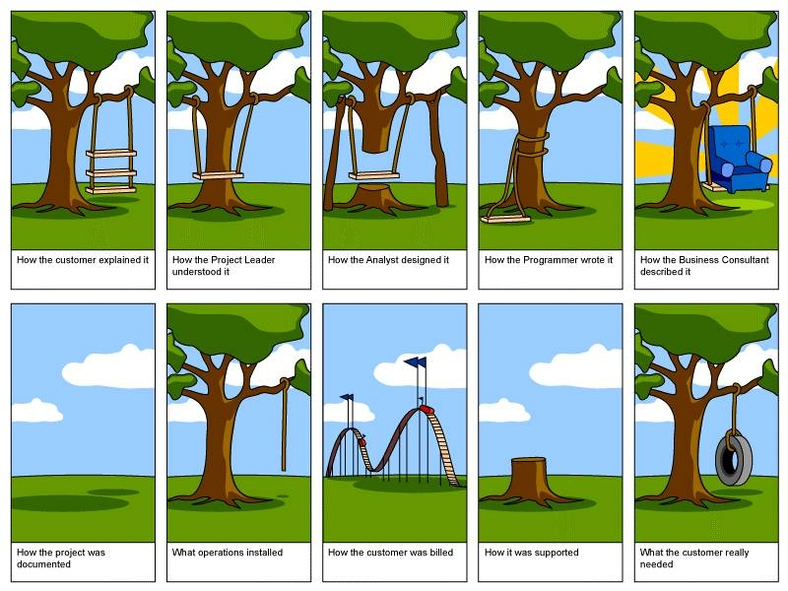

Slide 28
PM Tools and Techniques
Tools and techniques assist project managers and their teams in various aspects of project management.
Mechanism applied to the input to create the output
Some specific tools and techniques include:
Project charters, scope statements, and WBS (scope).
Gantt charts, network diagrams, critical path analyses, critical chain scheduling (time).
Cost estimates and earned value management (cost).

Slide 29
The Context of IT Projects
IT projects can be very diverse in terms of size, complexity, products produced, application area, and resource requirements
IT project team members often have diverse backgrounds and skill sets
IT projects use diverse technologies that change rapidly. Even within one technology area, people must be highly specialized

Slide 30
Special characteristics of IT projects
Invisibility: When physical artefacts such as bridge or road is being constructed the progress being made can actually be seen. With software progress is not immediately visible
Complexity: More complex then other engineering works
Conformity : Software developers have to confirm to the requirement of human clients.
Flexibility: That software is easy to change in seen as a strength. Software Systems are particularly subject to change

Slide 31
Importance of Software Project Management
Software projects have more frailer rate
Final project is invisible until it ends
Software Project use lot of effort, time , recourses & money
The need for Software projects keeps increasing

Slide 32
References
Kathy Schwalbe, “Information Technology Project Management”, Sixth Edition, THOMSON Course Technology, (ISBN 81-315-0123-X)
Harold Kerzner, “Project Management: A Systems Approach to Planning, Scheduling, and Controlling”, Wiley; 8th edition, ISBN: 0471225770
Bob Hughes, Mike Cotterell, Rajib Mall , “Software Project Management”, fifth Edition, Mc Graw Hill, ISBN 9780071072748

